Slide 1
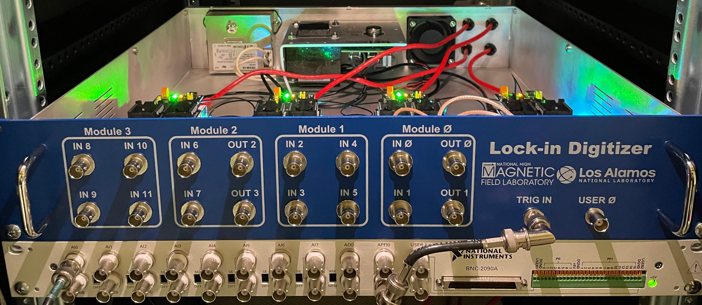
LOCK-IN OUTPUTS
LOCK-IN INPUTS
LOCK-IN INPUTS
LOCK-IN OUTPUTS
LOCK-IN INPUTS
LOCK-IN OUTPUTS
TRIGGER
TRIGGER

